Slide 1
Making Today’s Internet Faster
(Automatic Transition To Peer-to-Peer Download)

Slide 2
Thanks!
wE\=f P'P= \ROVIDE A U966554F545DS6TFDV87654536:01 PM 4/5/20102 098YH6Ya 1W N.I
Family
Teachers
Notes:
This is you
TODO: new pic

Slide 3
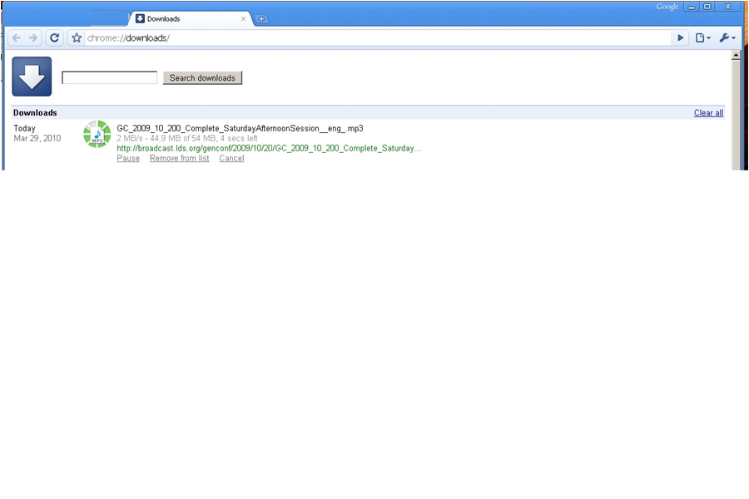
Fast download

Slide 4
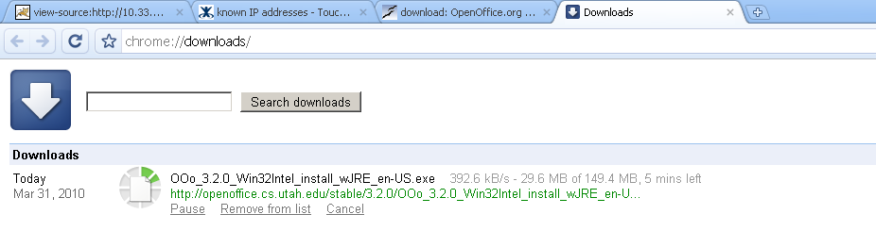
Slow downloads
Frustration
Wasted bandwidth
Notes:
Today's Internet is sometimes slow. It is.
This is very frustrating to today's work flow, and annoying.
"today's bottleneck is no longer the disk or cpu--it's the network!"
"all this wasted bandwidth“
Lodo:
Add a graph of network speed increasing so slowly compared to processors [?]

Slide 5
My options
Hit reload.
Try somewhere else.
Download Manager.
Add a local proxy.
Beg the server to change how they serve the file.
Notes:
Download manager—for me speeds things up, but hard to use because not integrated, also the server might run out of bandwidth.
Adding a local proxy doesn’t help if the file hasn’t been downloaded locally already—same exact problem in many cases.

Slide 6

Server options
Buy more bandwidth.
Move.
Buy more servers/rent a CDN
Popular
Flash flood.
Turn to P2P.
Notes:
TODO add CDN pic

Slide 7

P2P
Create BitTorrent File.
Host it, create tracker.
Peers download and share.
Works well sometimes.
Notes:
You don’t need any extra servers, peers do most of the extra hosting.
“Melissa style” explanation (you download half, your friend downloads half, you share halfs).

Slide 8
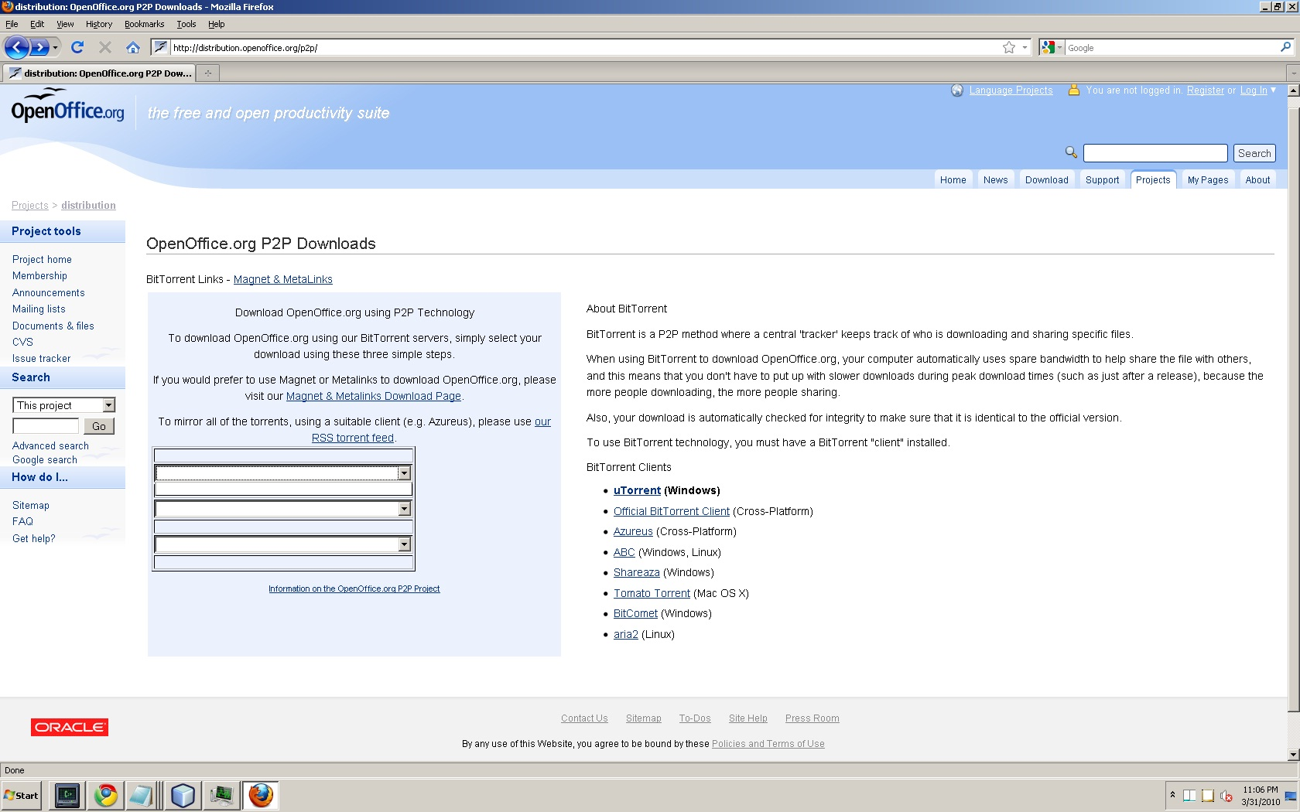
Hard to get right
Notes:
Hard to setup, Hard to use.
There are all sorts of barriers that keep this from actually working.
TODO new slide
1) The server has to set it up per file.
2) When a user runs into this, it typically takes extra time in order to download this way, because you have to go through some extra steps, like
Downloading the .torrent file, then waiting some time for your client to contact the tracker, get peer lists, find peers that are willing to share with you, etc.
3) It should be ignored. Typically (at least for me), it’s slower than just downloading it with the link they provide.
2) small files
It would be painful to have to do this for many small files, like browsing a web page. Up to 10 files for byu's web site. Even if they *did* a BitTorrent file for each of these small files, today’s systems include a manual step in order to download each file. Modern browsers don’t handle inline p2p. So P2P basically can’t be used for a typical web page.
Technology is there but not easily accessible.
Because of these barriers, few servers are setup to use BitTorrent, and many users ignore them even when they are, because of unreliable results.
----Some of the same:
It would annoy the user to death with today's system to have to go and get them all manually. Not as user-friendly
Barrier to entry: know how to use it, choose it, and it has to be fast. Many people ignore it.
Barrier for the server too: setting it up. Barrier to client: extra cost of time to download/unreliable can cause it to cost you extra time.
Barrier: not just the client, but you don’t know if using the client will actually be faster. Many times it isn’t.
And some sites don’t offer P2P.
How many sites actually offer you that stuff?
1) should be ignored typically [it's slower (but you're never sure when), non standard, typically not integrated with normal HTTP sites--except in a few rare cases].
3) Though awesome, most servers don't allow you this option [unless they offer large popular files], as it's extra hassle, non-conventional.
[plus any other goals that are actually worth mentioning]

Slide 9
Automatic Swarming
Basic Algorithm:
Monitor download
Download blocks from Peers when becomes slow.
Notes:
We provide a new option for Internet users—Automatic Swarming, which aims to alleviate these problems.

Slide 10
Automatic Swarming Benefits
Automatic transition
Small files
Client-server plus P2P
Client-side protocol
Notes:
" [cross each one out in turn] -- ours is a purely client-side modification, so servers don’t have to be set up with extra configuration
To participate, nor even opt-in ... [3]
Ours provides an automatic transition to P2P, so even with small files it can switch automatically, which makes it more user-friendly [no manual intervention required] [2].
Ours uses standard client-server until this is deemed slow, so it "knows" when P2P will be faster, thus alleviating the user from having to choose whether to ignore it or not [1].

Slide 11
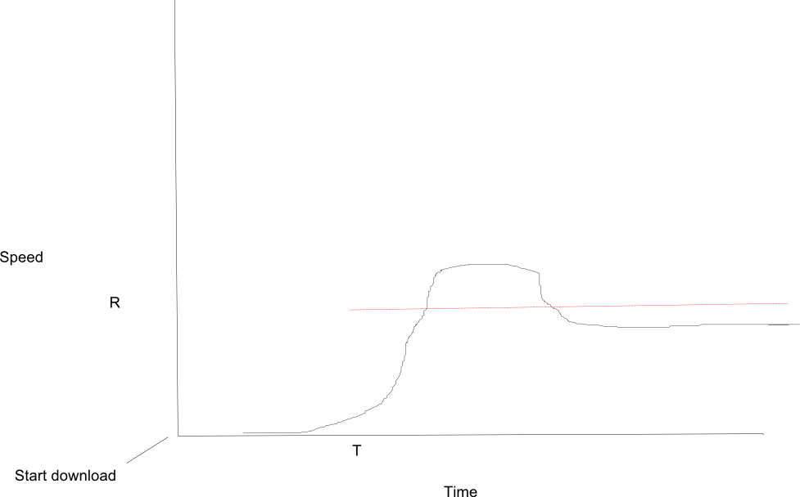
Monitor Download
Notes:
TODO ADD W TO THIS

Slide 12
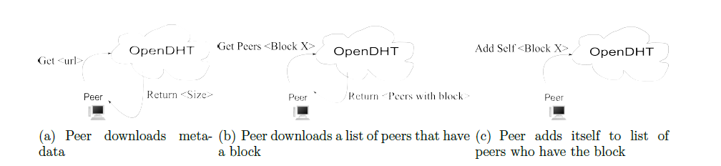
Find Peers, share
Notes:
No more depth needed, uh guess.

Slide 13
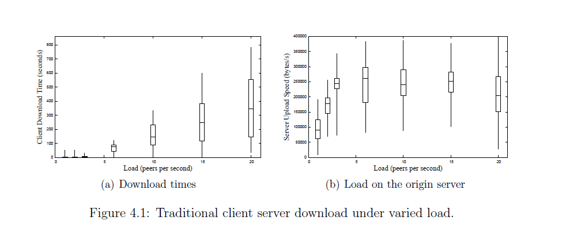
Performance Client-Server

Slide 14
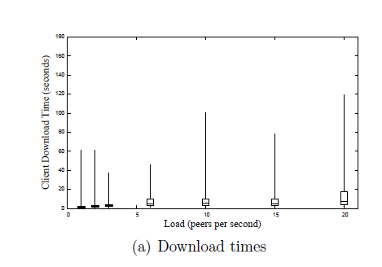
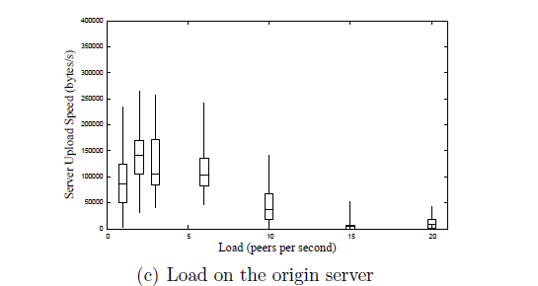
Performance – Automatic Swarming

Slide 15
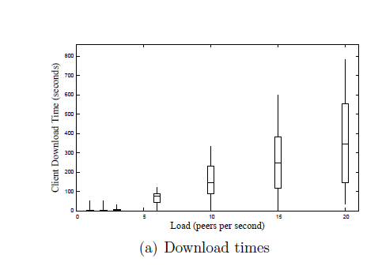
Comparison
Notes:
This is no comparison. Show once I have a real graph.

Slide 16
Effect of Varying Parameters
T, R, W
Multiple Files
Large Files
Block Size
Linger Time
Peer count
Notes:
Say what type of loads we’re going to use (et al).

Slide 17
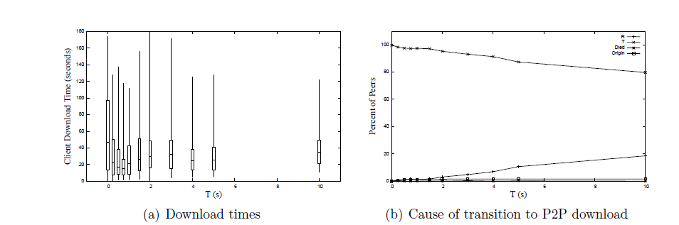
Varying T

Slide 18
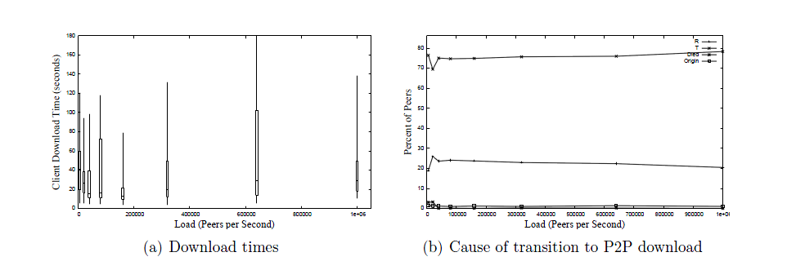
Varying R
Notes:
Please another graph here. Please?

Slide 19
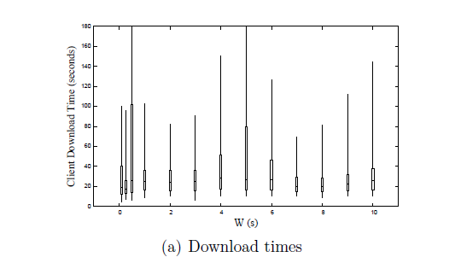
Varying W
Notes:
Not much change, really. Because it only affected at most the first few, because after that the server became saturated and T would always fire first.

Slide 20
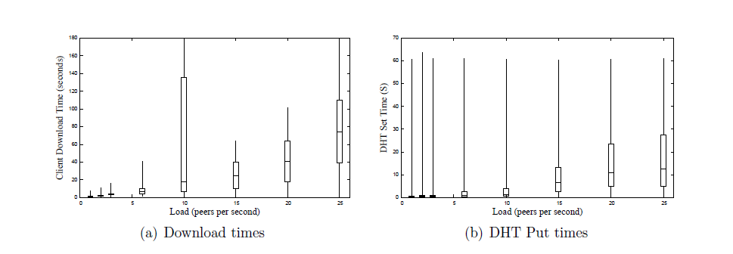
Full web Page
Notes:
Note that our linger time was 20 seconds, so the DHT was becoming less effective under higher load.

Slide 21
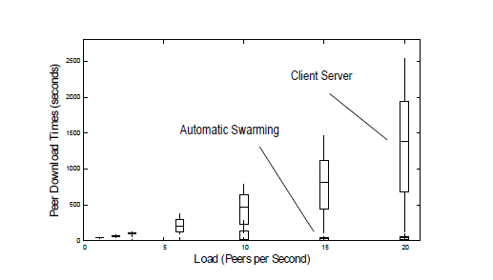
Versus Client-Server

Slide 22
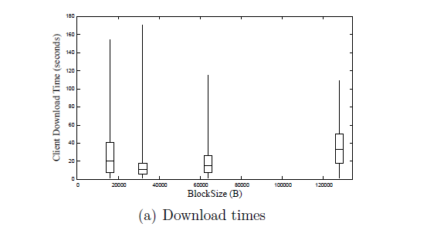
Block Size
Notes:
Fastest was 32 KB, presumably because I download from the last few peers in parallel, so this fits best.

Slide 23
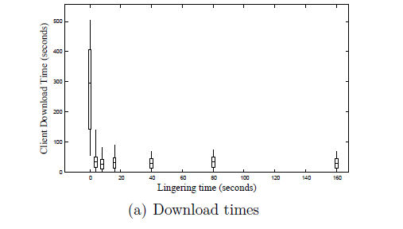
Linger Time

Slide 24
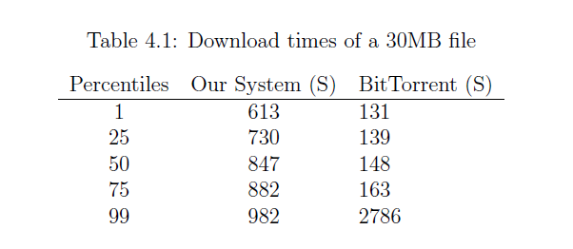
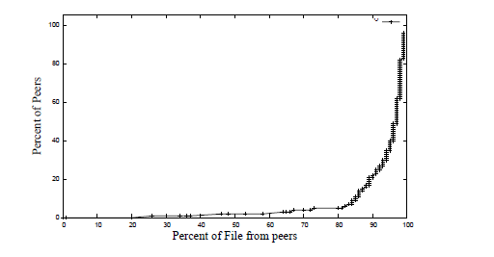
With Large Files
Notes:
“Ours doesn’t perform as well as BT for large files.”
You can see that at about 730 to 882 seconds most of our peers finish the file, and most of the peers download it from peers, so once we get the file out there we work all right, but we could do some work still to increase our speed of propagating the blocks.”

Slide 25
Conclusion
Viable.
30 x as fast for small files
Transparent to servers
Automatic for end users
Notes:
"real" use is probably currently [who knows for sure] "most useful in the wild" for larger static files, still.
Kind of an auto-BitTorrent for all files on the Internet, though we have shown it can work well for small files, too, so something like this could become
A real contribution to browsing the Internet.
Demo?

Slide 26
Future Work
Back off the origin.
Validate Integrity.
Differentiate better for static/non-static.
Better use of the DHT (fairness, speed).
Dynamic parameters.
Incentives.
Privacy.

